Slide 1

Presentation to ICICI Bank
Groffr White-Labeling Solution for Facebook Initiatives
November 2013

Slide 2

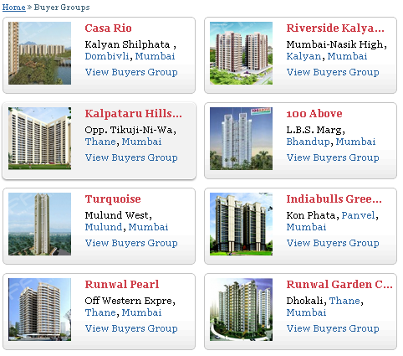
FB Integration and Strategy
Aim – To increase online referrals and tracking of leads for HFC and PSG group
Resource – Groffr’s Home Buyers’ Groups on Facebook
FB groups & content already present on Groffr.com. Import their links & Forum discussions on ICICI Bank’s page on FB

Slide 3
Create a new home-loans app to be hosted on ICICI Page

Slide 4
Groups open directly in Facebook App. Users have to use FB login
“Form your group” to discuss this with your close friends (Step 5)

Slide 5
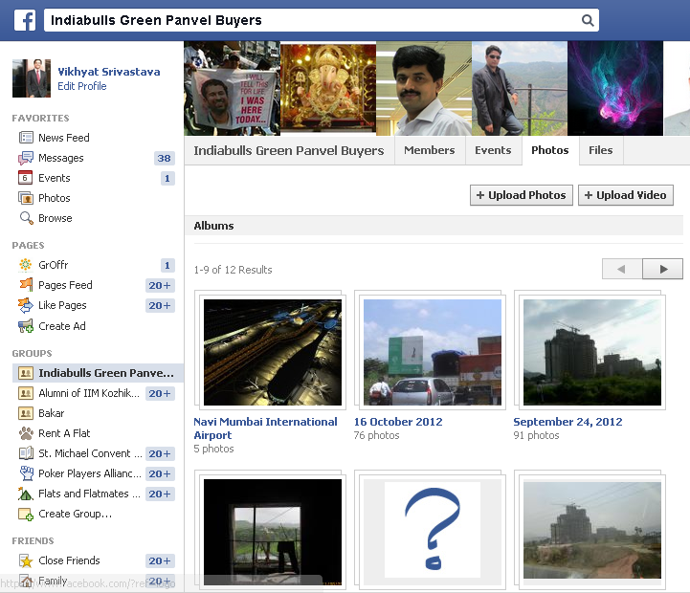
Project pages to have all the project information – admin & user generated
Project brochures,
layout etc will be
uploaded
Facility for CUG
discussions
Users can upload latest
construction photos

Slide 6
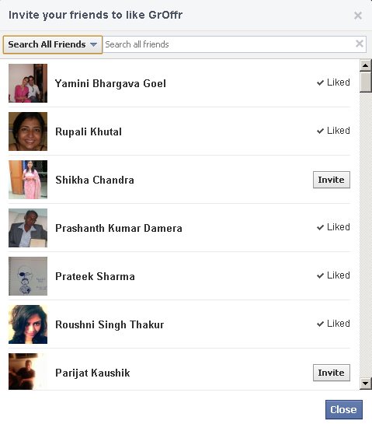
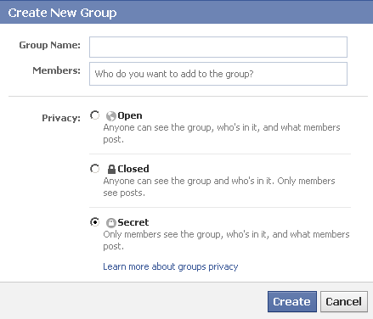
Users can create CUG to discuss home loans & projects without public glare

Slide 7
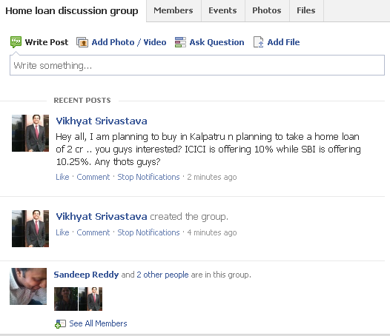
CUG discussions enhance virality and participation

Slide 8
Costing Proposal
Technology Licensing – INR 4 lakhs one time
AMC – 8% p.a. of one time technology license with 10% step-up p.a.
Content Licensing & Updation – INR 1 Lakh p.a
Discussion facilitation managers – INR 25,000 pm per head
Change Request – TBD on specifications
Disclaimer:
1. The pictures shown herewith are pictorial representation. The design and functionalities may differ in actual product. Costing subject to Service Purchase Agreement clauses.
2. All figures mentioned are excluding statutory taxes.

